Slide 2
Heredity Notes
Biotechnology and genetic techniques
Recombinant DNA technique is used to genetically modify DNA
  Gene cloning
  GMO
  Transgenic Organisms

Slide 3
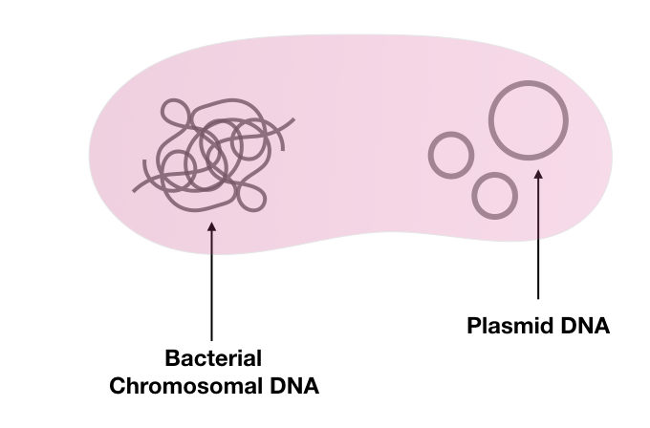
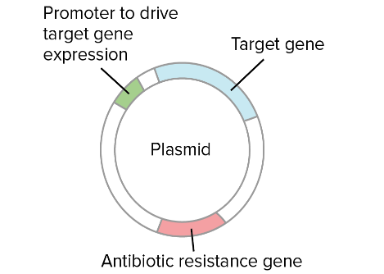
Syllabus:
Recombinant DNA technology and DNA identification technologies are applied in agriculture and environmental conservation
Describe how recombinant DNA technology is used to clone genes
Describe how recombinant DNA technology is used to genetically modify an organisms DNA and create a transgenic organism
Heredity
Essential
Question:
BIOLOGY WA UNITS 3&4
Chapter 6 Biotechnology- Its Tools and Techniques pg. 169-198
Set 6.2 pg. 174 Q1-6 DNA TOOLS USED IN BIOTECHNOLOGY
Set 6.3a pg. 180 Q1-7 DNA TECHNIQUES & VOCAB AND PCR
Set 6.6 pg. 198 Q1-4RECOMBINANT DNA TECHNOLOGY & TRANSGENIC ORGANISMS
BIOZONE Activity Number:
APPLICATIONS OF BIOTECH 151, 152,
TERMINOLOGY 162
GMO & RECOMBINANT DNA 141, 142, 143, 144, 159, 160,
GENE CLONING 156, 157, 158,
ETHICS OF GMO 161,
Topic Question 1:
Explain why plasmids can be used to copy DNA

Slide 4
Topic Question 2:
Define the terms GMO and transgenic organism
Part of the gene cloning process | Role
Restriction enzymes
Ligase
Plasmid
Vector
Topic Question 3:
State the role of restriction enzymes, ligase, plasmid and vector play in gene cloning

Slide 5
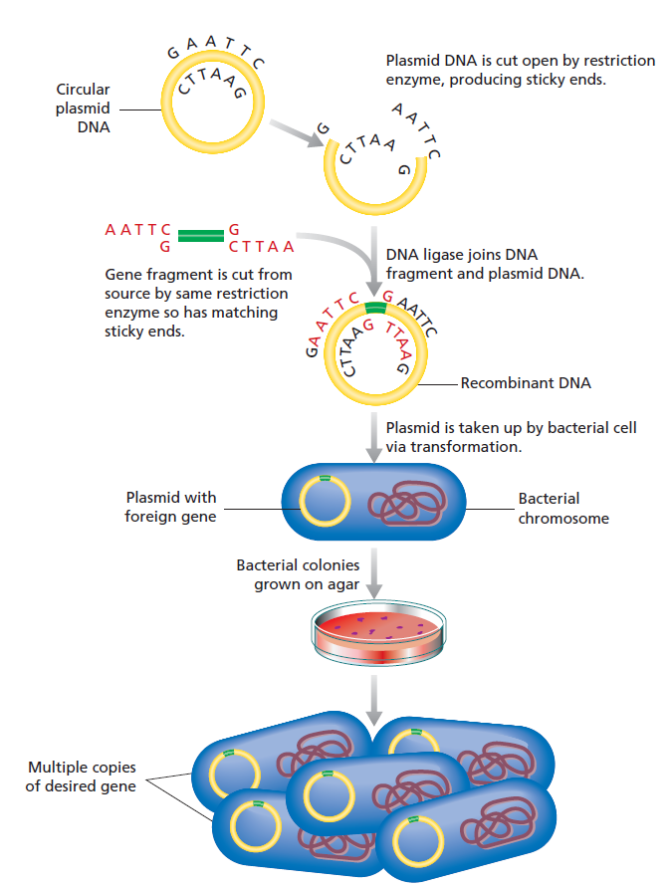
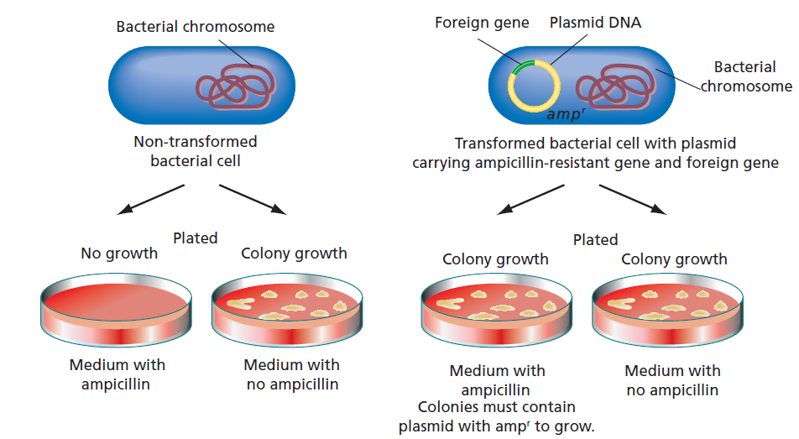
Topic Question 4:
Describe how recombinant DNA technology can be used to genetically modify bacteria to produce a protein it does not normally
​
Topic Question 5:
Describe how scientists identify which bacterial cells contain recombined DNA

Slide 6
Topic Question 6:
Agrobacterium tumefaciens is a species of soil-borne bacteria that can infect plant cells and cause crown gall disease. A tumefaciens is widely used in recombinant DNA technology as a vector for gene transfer.
Outline why Agrobacterium is well-suited to this role of vector in creating transgenic plants
​
Topic Question 7:
Agrobacterium tumefaciens is a species of soil-borne bacteria that can infect plant cells and cause crown gall disease. A tumefaciens is widely used in recombinant DNA technology as a vector for gene transfer.
Outline how Agrobacterium is used in the production of transgenic plants
​

Slide 7
Topic Question 8:
Agrobacterium tumefaciens is a species of soil-borne bacteria that can infect plant cells and cause crown gall disease. A tumefaciens is widely used in recombinant DNA technology as a vector for gene transfer.
Construct a labelled flow diagram outlining the stages involved in the development of a transgenic plant using Agrobacterium tumefaciens.
​

Slide 8
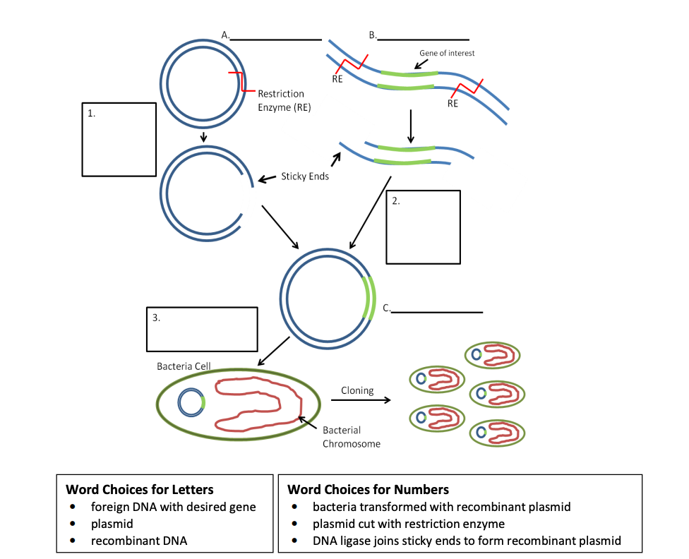
Sum it up!
Draw a diagram showing the processes that are required to create a transgenic plant
Label the diagram above and describe the process of cloning a gene using bacteria

